Slide 1
Python Data Analyst project Roni Sheffi – ID 308562628

Slide 2
The Data and the motivation
With this data we will try to make a model that will predict if a customer is about to churn
The database consists of features of the customer, the services he used and his payment methods
The motivation for solving the problem is to reduce the churn rate, customers loss will lead to revenue loss.
In this project the data was analyzed with Python language using Panda, Matplotlib and Seaborn libraries.

Slide 3
Data description
The dataset contains of 7043 examples and 21 columns
Those examples are divided to test and train groups (train 80%, test 20%)
Classifications of Churn dataset fields:
Information about the customers:
Customer Id, gender,
Is he a senior citizen,
Whether he is independent.
Information about the services :
Has services like: phone, internet, online security, backup,
Multiple lines,
protection, tech support, streaming TV , streaming movies
Information about the payments:
Payments method, monthly and total charges, term of contract
Number of months the customer has stayed

Slide 4
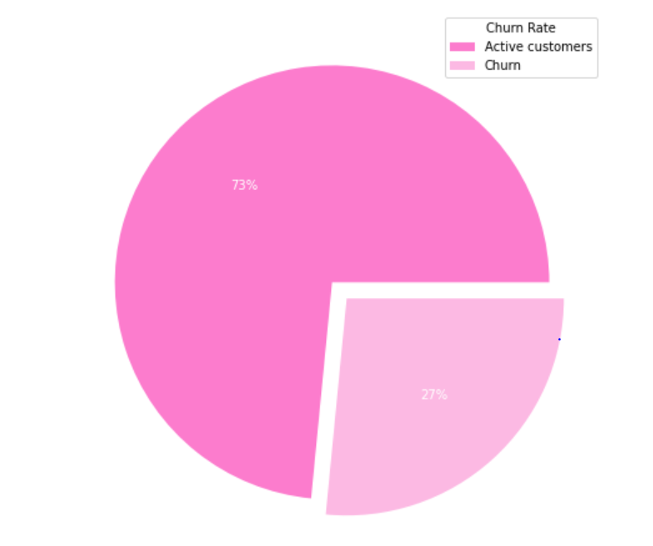
Data description
Distribution of the label, The churn rate, measures a company's loss of subscribers for a given period of time.

Slide 5
Data description – Missing values
In the process of finding inaccurate or Null records from the record set I first used churn.info() method.
we can see that there aren't NULL values in the data.
Never the less, the column ‘Total Charge’ is typed as ‘Object’.
All the empty values in that column are switched to the mean value of ‘Total Charge’
In addition, there are some columns that have three kind of values (YES,NO,NO SERVICE). Those fields get the value 1 for ‘yes’ and o for the other values.

Slide 6
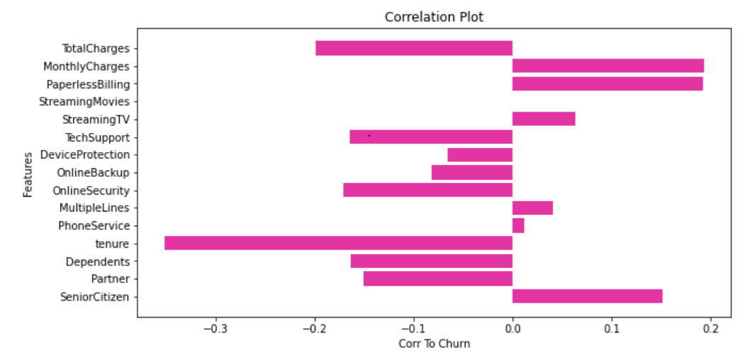
Data description – Correlation Between features
for focus on the main features that effect the churn I used ‘barh’ graph:

Slide 7
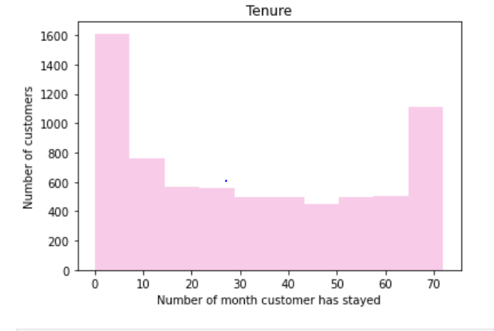
Data description - Tenure
Tenure is defined by the number of month a customer stayed with the company.
I split tenure column to three different groups, New customers (Less than 10 months), Long term customers(More than 65 months) and Avg term customers.
According to this classification I created a new column called ‘Tenure Group’

Slide 8
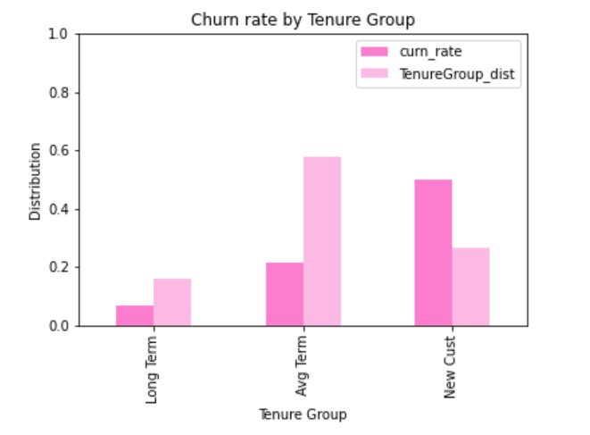
Data description – Tenure Group
In the graph we can see the distribution rate and churn rate for every tenure group.
* The graph is sorted by churn rate

Slide 9
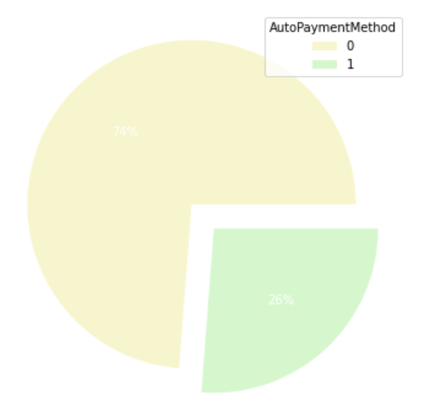
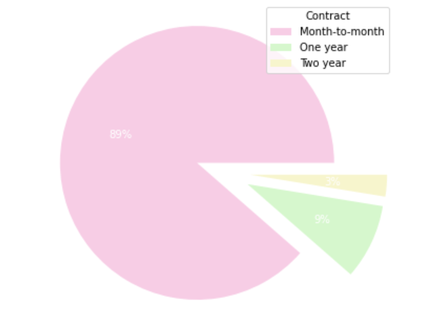
Contract feature
Payment method
Distribution of customers that had churned by contract term
I created a new feature for Automatic payments from column ‘Payment method’
Distribution of customers that had churned using or not using automatic pay method

Slide 10
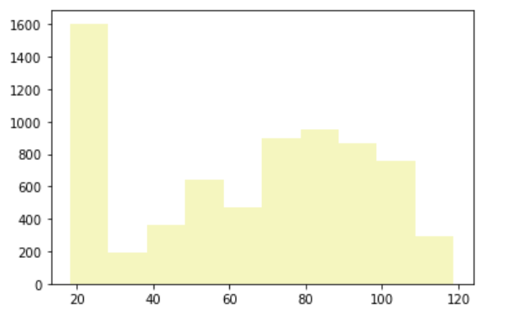
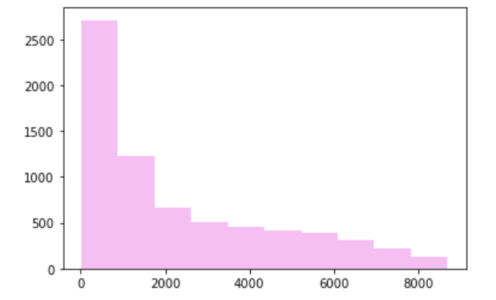
Data description – MonthlyCharges
Data description – TotalCharges

Slide 11
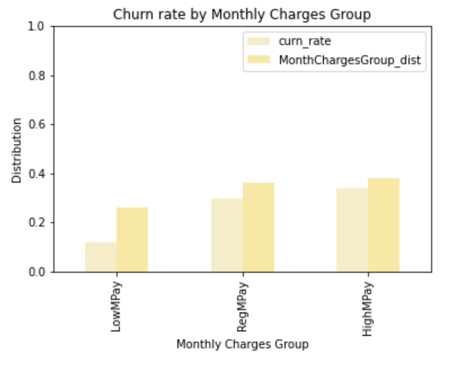
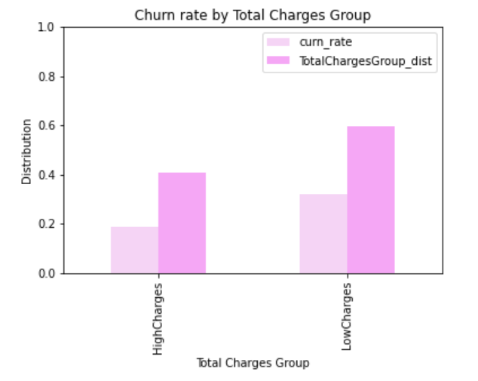
Monthly Charges
Total Charges
Splitting Monthly charges to three groups – High, Avg, Low and presenting the churn rate for each group
Splitting Monthly charge to two groups – High, Low and presenting the churn rate for each group
.

Slide 12
New features
'Electronic check', 'Mailed check'
Automatic payments – based on ‘PaymentMethod‘ filtering whether the payment is automatic(Bank transfer (automatic), Credit card (automatic) ) or not (Electronic check, Mailed check).
Tenure Group – Includes Tenure ranges(New cust, Long term, Avg term)
Total charges group - Includes Total charges ranges(LowCharges, HighCharges)
Monthly charges group – Includes monthly charge ranges(LowMpay, RegMpay, HighMpay)
Splitting contract field to three different Boolean columns by ‘contract’ values (‘Two year’, ’One year’, ’Month-to-month)
Splitting gender field to two different Boolean columns by ‘gender’ values (‘Female’, male’)

Slide 13
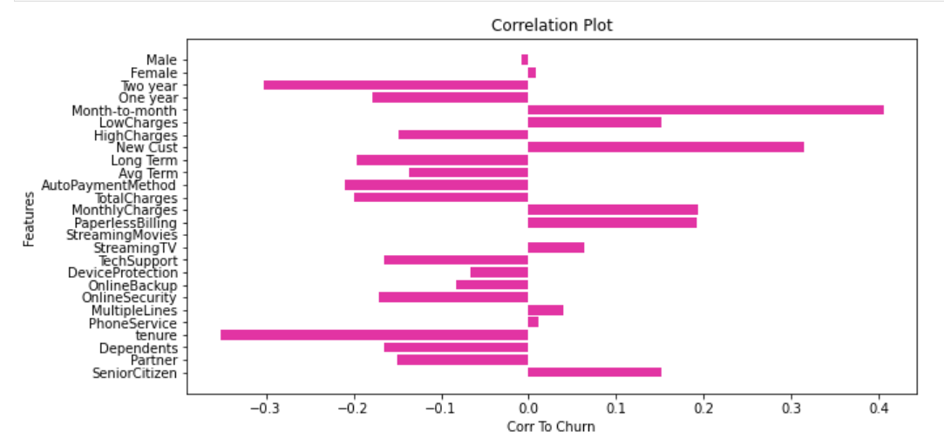
Drop features
The new correlation after adding new features
I dropped some features that had a small correlation to churn or exists in new feature that I created– ('Male','Female','tenure','MonthlyCharges', 'TotalCharges','PhoneService','MultipleLines‘ ,'OnlineBackup','DeviceProtection','StreamingTV','StreamingMovies‘)

Slide 14
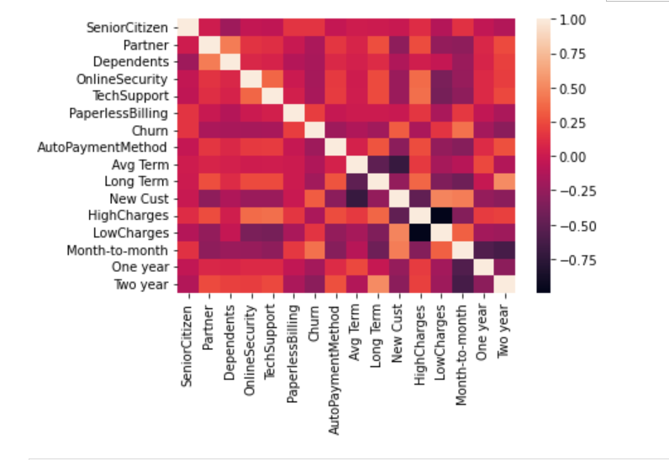
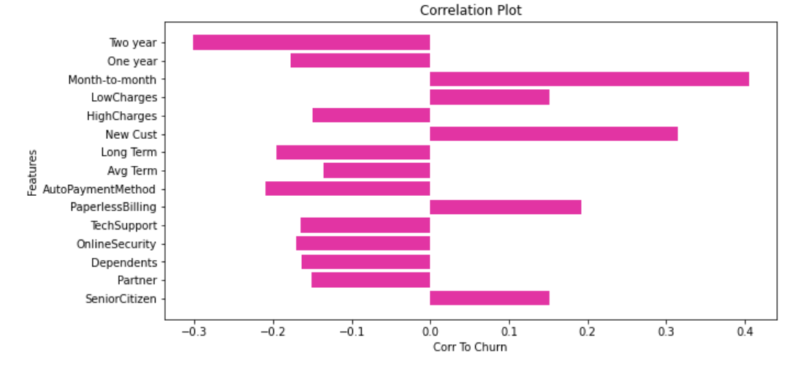
Heat map & Final feature correlation

Slide 15
ML Algorithms – testing the following algorithms:
K nearest neighbors:
The accuracy result is: 0.789
The best accuracy result was obtained with K value = 11
Random forest :
The accuracy result is: 0.791
The best accuracy result was obtained with n_estimators = 10 ,max_depth = 9
Decision Tree:
The accuracy result is: 0.781
The best accuracy result was obtained with max_depth = 7

Slide 16
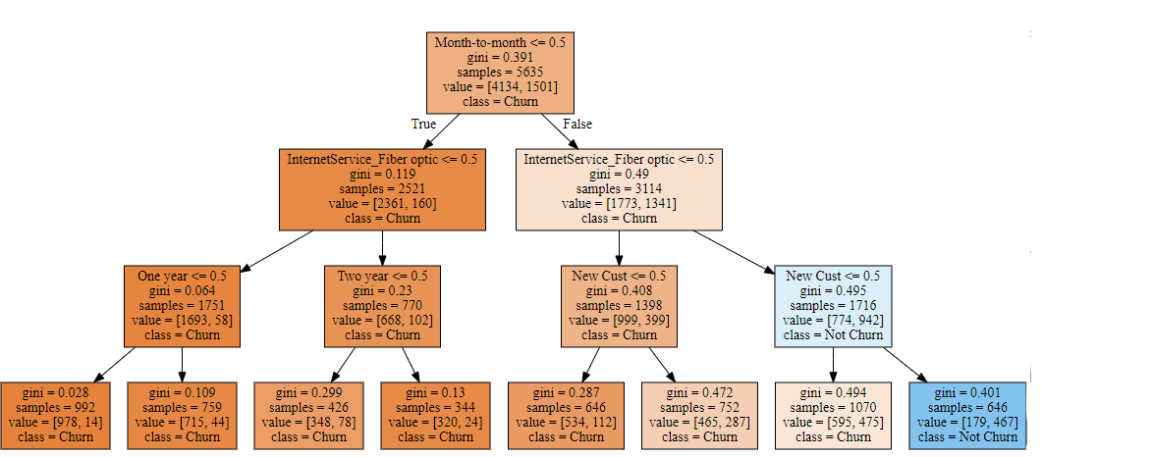
Decision Tree

Slide 17
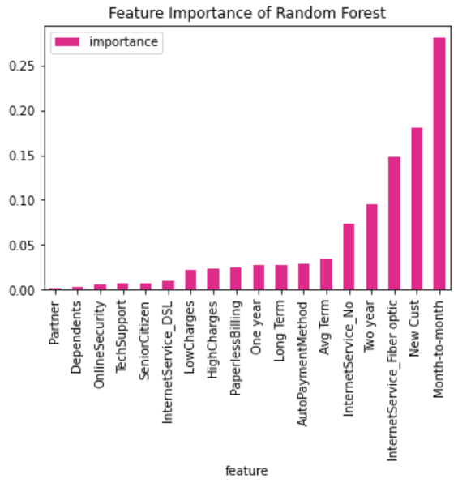
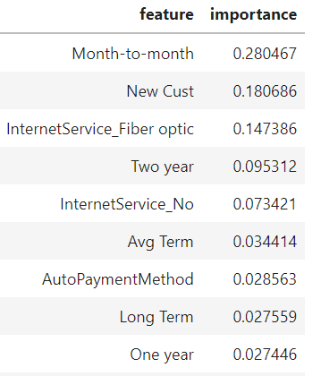
Random forest features importance

